Slide 1
Algorithms
Muhammad Ehsanul Kader

Slide 2
Introduction
Faculty Name: Muhammad Ehsanul Kader
USIS initial: EHD
Consultation Hours:
Sunday, Monday, Tuesday, Wednesday: 12:30PM-1:50PM
Desk: 4M113
Email: ehsanul.kader@bracu.ac.bd
Resources: https://tinyurl.com/ehd221spring25
Slack link: https://join.slack.com/t/algorithmscse-pic3691/signup

Slide 3
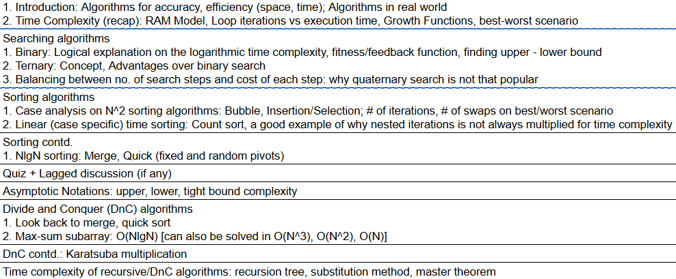
Topics we will cover before mid

Slide 4
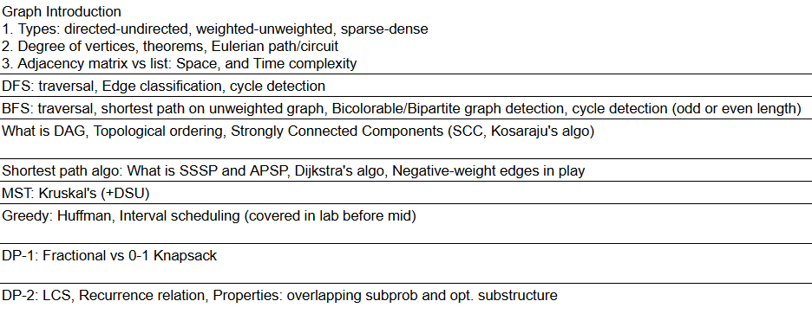
Topics we will cover after mid

